Slide 1
Inter Process Communication and Threads
Tahira Alam
University of Asia Pacific

Slide 2
Inter Process Communication (IPC)
Processes within a system may be independent or cooperating
Cooperating process can affect or be affected by other processes, including sharing data

Slide 3
Inter Process Communication (IPC)(2)
Processes do not share any memory with each other
Some processes might want to work together for a task, so need to communicate information
IPC mechanisms to share information between processes

Slide 4
Reasons for IPC
Information sharing
Computation speedup
Modularity
Convenience

Slide 5
Two models of IPC
Shared memory
Message passing

Slide 6
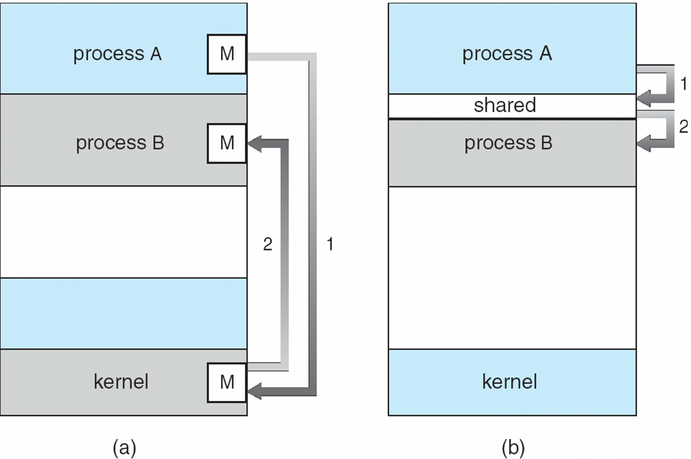
Communications Models

Slide 7
Shared Memory
Processes can both access same region of memory via shmget() system call
int shmget ( key_t key, int size, int shmflg )
By providing same key, two processes can get same segment of memory
Can read/write to memory to communicate
Need to take care that one is not overwriting other’s data: how?

Slide 8
Signals
A certain set of signals supported by OS
– Some signals have fixed meaning (e.g., signal to terminate process)
– Some signals can be user-defined
Signals can be sent to a process by OS or another process (e.g., if you type Ctrl+C, OS sends SIGINT signal to running process)
Signal handler: every process has a default code to execute for each signal
– Exit on terminate signal
Some signal handlers can be overridden to do other things

Slide 9
Sockets
Sockets can be used for two processes on same machine or different machines to communicate
– TCP/UDP sockets across machines
– Unix sockets in local machine
Communicating with sockets
– Processes open sockets and connect them to each other
– Messages written into one socket can be read from another
– OS transfers data across socket buffers

Slide 10
Pipes
write
read
Pipe system call returns two file descriptors
– Read handle and write handle
– A pipe is a half-duplex communication
– Data written in one file descriptor can be read through another
• Regular pipes: both fd are in same process
(how it is useful?)
– Parent and child share fd after fork
– Parent uses one end and child uses other end
• Named pipes: two endpoints of a pipe can be in different processes
• Pipe data buffered in OS buffers between write and read
P(read)
P(write)
C(write)
C(read)
A(write)
B(read)

Slide 11
Message Queues
Mailbox abstraction
Process can open a mailbox at a specified location
Processes can send/receive messages from mailbox
OS buffers messages between send and receive

Slide 12
Remote Procedure Calls
Remote procedure call (RPC) abstracts procedure calls between processes on networked systems
Stubs – client-side proxy for the actual procedure on the server
The client-side stub locates the server and marshalls the parameters
The server-side stub receives this message, unpacks the marshalled parameters, and peforms the procedure on the server

Slide 13
Blocking vs. non-blocking communication
Some IPC actions can block
– Reading from socket/pipe that has no data, or reading from empty message queue
– Writing to a full socket/pipe/message queue
• The system calls to read/write have versions that block or can return with an error code in case of failure
– A socket read can return error indicating no data to be read, instead of blocking

Slide 14
Now,
Threads

Slide 15
Threads
A thread is the smallest sequence of programmed instructions that can be managed independently by a OS scheduler.

Slide 16
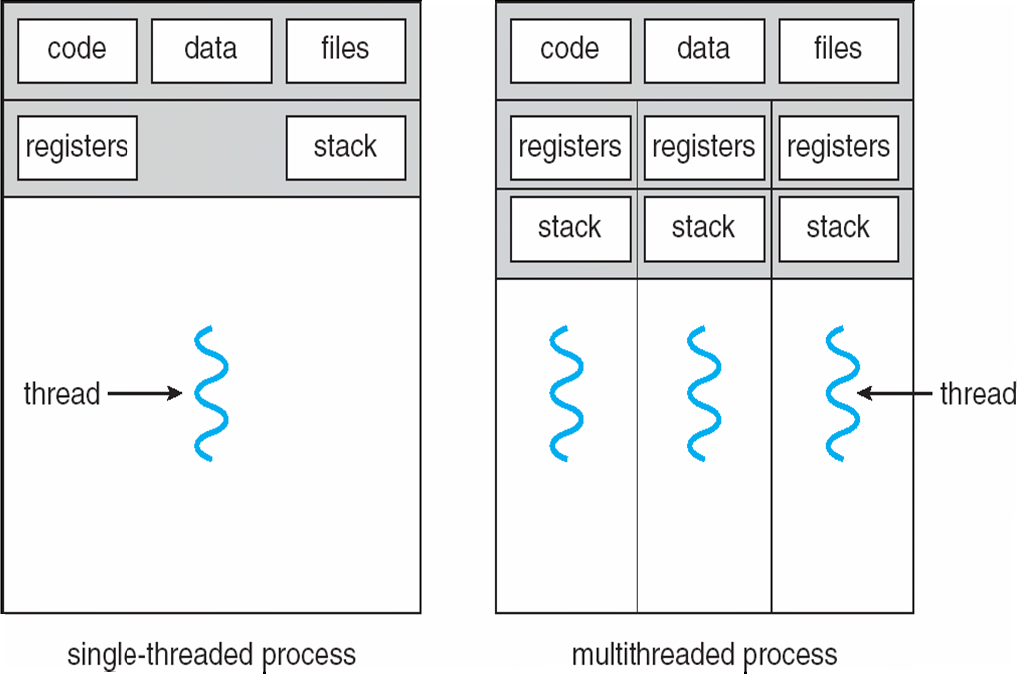
Single and Multithreaded Processes

Slide 17
Benefits
Responsiveness
Resource Sharing
Economy
Scalability

Slide 18
Multicore Programming
Multicore systems putting pressure on programmers, challenges include:
Dividing activities
Balance
Data splitting
Data dependency
Testing and debugging

Slide 19
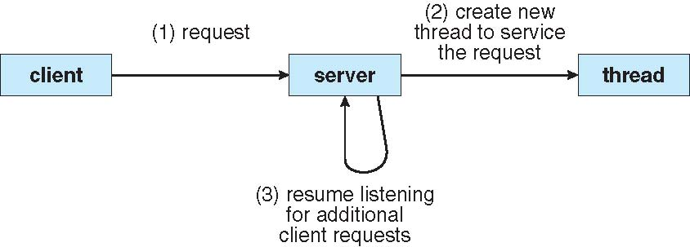
Multithreaded Server Architecture

Slide 20
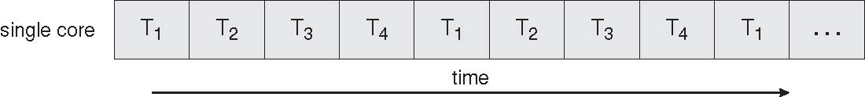
Concurrent Execution on a Single-core System

Slide 21
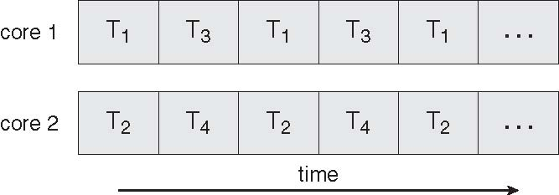
Parallel Execution on a Multicore System

Slide 22
User Threads and Kernal Thread
User Threads: Thread management done by user-level threads library
Kernel Threads: Supported by the Kernel

Slide 23
Multithreading Models
Many-to-One
One-to-One
Many-to-Many

Slide 24
Many-to-One
Many user-level threads mapped to single kernel thread

Slide 25
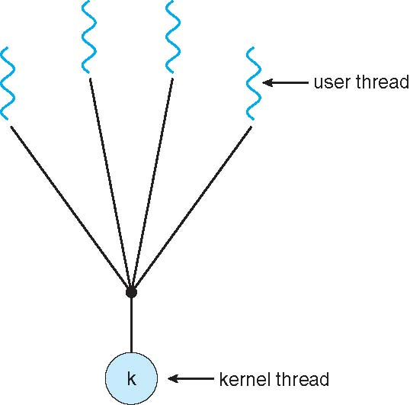
Many-to-One Model

Slide 26
One-to-One
Each user-level thread maps to kernel thread

Slide 27
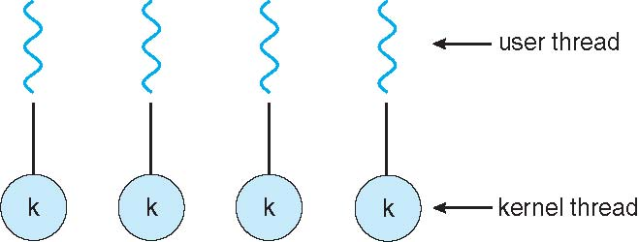
One-to-one Model

Slide 28
Many-to-Many Model
Allows many user level threads to be mapped to many kernel threads
Allows the operating system to create a sufficient number of kernel threads

Slide 29
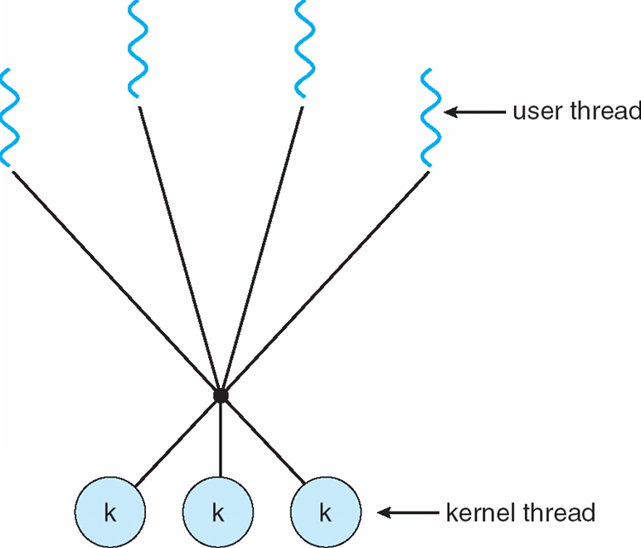
Many-to-Many Model

Slide 30
Thank you!

